Slide 1
The Sleuth Kit
Caitlyn Cashion

Slide 2
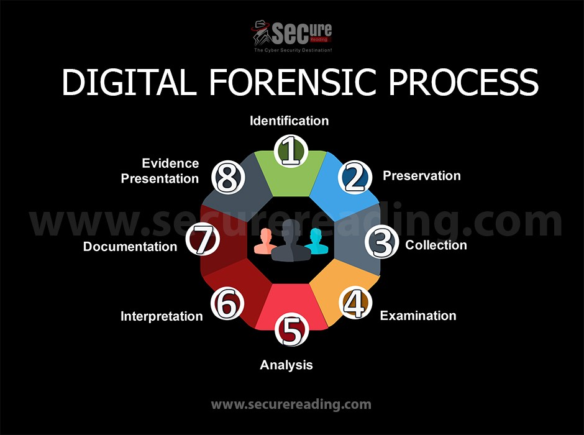
Digital Forensics
The primary career that uses The Sleuth Kit
Responsibilities of digital forensic analysts
Recovering data (breached, modified, destroyed, etc.)
Investigates and learns how hackers are able to gain access to networks
Recording and logging evidence from security breaches
Important roles within law enforcement investigations and trials
Many other tools used
FTK (Forensic Toolkit) – disk imaging
Oxygen Forensic Suite - Mobile
Wireshark – network
John the Ripper – Password Cracking

Slide 3
What is The Sleuth Kit?
Open-source forensic toolkit (Linux/UNIX, Windows, and macOS)
Supports NTFS, FAT, ExFAT, APFS, UFS 1, UFS 2, EXT2FS, EXT3FS, Ext4, HFS, ISO 9660, and YAFFS2
Large library of command-line forensic utilities
Analyzes file systems and disk images
Raw single(.img, .dd, .raw, .bin)
Raw split(.001, .002, .aa, .ab,)
Encase(.E01, .E02)
Virtual Machines(.vmdk, .vhd)
Allows the recovery of deleted files and directories
Operating system is not relied on, which allows deleted/hidden content to be shown
https://www.sleuthkit.org/

Slide 4
Autopsy
Digital forensics platform and GUI
Built on top of TSK
Makes digital investigations easier by providing visual ways to work with disk images, file systems, etc.
Simplifies command-line tools
Analyze hard drives and smart phones
Features within Modules
Timeline analysis
Keyword search
Web artifacts
Hash Filtering
Data Carving
Malware scanning

Slide 5
File System Analysis & Time Creation
Two key features apart of TSK
File system
Recover deleted files
Extract metadata
List directory contents
Examine file system structures
Timeline Creation
Mactime
Generate timelines of file activity based on MAC times (modified, accessed, changed created)
2 step process (gather temporal data and sort and merge)

Slide 6
Command-Line Tools
File System Analysis | Disk and Volume | File Extraction and Recovery | Disk Image Handling
fsstat | mmls | icat | img_stat
fls | mmstat | img_cat | img_cat
istat | fsstat | tsk_recover
ils
ffind
Sectors – smallest addressable units of data on a disk
Building blocks of how data is stored and read
Partitions – Division of a hard drive into multiple drives (virtually, not physically)
Each has a certain amount of storage space
Separation of system files from personal data

Slide 7
Github
https://github.com/CashionCaitlyn/IT-250-Project

